Slide 1
Scheduler Activations
Effective Kernel Support for the User-Level Management of Parallelism
Thomas E. Anderson
Brian N. Bershad
Edward D. Lazowska
Henry M. Levy
University of Washington
Notes:
[ Introduce Paper ]
1991 SOSP Conference
Another paper which I used as a reference, and will be mentioning explicitly later in the presentation was
An Implementation of Scheduler Activations on the NetBSD Operating System
Nathan J. Williams
Wasabi Systems, Inc.

Slide 2
Problem
Threading increasing in popularity
Kernel-level and user-level threads are the only options
Notes:
The year is 1992, threading is becoming increasingly popular as an alternative to heavy unix processes. The two implementations of threads, kernel-level and user-level threads, had inherent strengths and weknesses.

Slide 3
Kernel-level Threads
“1:1 model”
Kernel creates, schedules, synchronizes, etc
Thread blocking doesn’t affect the rest of the process
Notes:
Kernel threads are known as a “1:1 model” of threading as there is a direct correspondence between the number of threads and resources.
The kernel is in charge of creating, scheduling, synchronizing, threads, as well as all other thread operations.
One benefit to kernel threads is that when a thread is blocked due to a kernel operation, such as a page fault, only that thread is affected, not the entire process.

Slide 4
Kernel-level threading downsides
High overhead of system calls
Generalized
Notes:
That being said, kernel-level threading requires all thread management to be handled through system calls, which have a relatively high overhead.
Additionally, as we have seen for many other systems, there is often no general approach that works best for every program. We can not have a specialized scheduling algorithm, or easily choose what thread from a specific process should be run. As we have in other systems, we can solve this problem, at least partially, by pushing the solution to user-space.

Slide 5
User-level threads
“N:1 model”
FSU Pthreads, PTL2, FastThreads
Self scheduling with specialized scheduling algorithms
More flexibility
Lightweight
Notes:
As an alternative to kernel-level threads, user-level threads use what is known as an “N:1 model”, or a model that maps N application threads to a single kernel resource.
Examples of user-level threading libraries of the time were FSU Pthreads, PTL2, and FastThreads, which this paper used as a base for its implementation.
The benefits of a user-level thread library is the ability to be more flexible and specialized, like specifying its own scheduling algorithm
Additionally, we don’t have the overhead of making a system call everytime we want to perform a thread operation like creation

Slide 6
User-level thread downsides
Purely user-level threading can only use one processor
Operations that block (I/O, page fault) block entire process
Notes:
There are downsides to user-level threads however. Because all threads of a single process are mapped to one processor, we can only use one processor. This means that if a thread blocks on a kernel event, then the entire program is blocked and can’t continue until the event finishes and the thread is rescheduled.
Additionally, as the paper states “In the presence of [multiprogramming, I/O, and page faults] user-level threds built on top of traditional processes can exhibit poor performance or even incorrect behavior”

Slide 7
Unix Processes < Kernel threads < User threads
Notes:
So, generally, what we’ve seen is that multiple unix processes perform worse than a similar implementation using kernel threads, and both perform worse than user level threads.
We can do better though.

Slide 8
Scheduler Activations
“N:M model”
Processes each given a “virtual processor”
User-level scheduling
Low cost of creating, swapping, etc
Multiprocessor
Notes:
Thats where scheduler activations come in.
Scheduler activations are whats known as an “N:M model” because now we are mapping N application threads to M kernel resources, where N is generally larger than M.
Each process is given a set of virtual processors which correspond to physical processors where it runs its threads.
With Scheduler activations we get the best of both worlds - we can customize our scheduling algorithm and a process can handle its own scheduling. There is a low cost of creating, swapping, and performing other thread operations because we aren’t required to make a syscall for each operation.

Slide 9
General Approach
Kernel allocates processors to each process
Applications know what processors they have been allocated
Requires communication
Notes:
In a Scheduler Activation setup, very simply, the kernel is in charge of allocating processors. It decides which processes get what number of processors, and at any time can change the number of processors an application owns.
Applications know how many processors they own, allowing them to make decisions like which thread should schedule.
This requires a lot of communication however… [Next slide]

Slide 10
Communication
Kernel notifies application when
granting additional processor
A processor is preempted
Thread blocks, or finished blocking in Kernel
User level notifies kernel when
It requires more or less processors
Notes:
More specifically, there are certain events that the kernel must notify the application about, and the application must notify the kernel about.
The kernel will notify the application when granting some number of processors, when the kernel preempts a process, or when a blocking event in kernel space, such as a page fault, occurs of finishes
Conversely, the program will notify the kernel it requires more or less processors, allowing for better allocation of processors among applications.
But how does it achieve this communication?

Slide 11
Scheduler Activations
Each thread has its own SA
Given when thread starts on processor
Two execution stacks (one kernel, one user space)
Notes:
First I need to talk about what Scheduler activations actually are
Each thread has its own scheduler activation which is tied to the virtual processor it lives on. The SA is allocated when the thread first starts on a processor.
The SA contains two execution stacks, one in kernel space and one in user space, which are used when making calls from one space to the other. For example, when the application wants to tell the kernel it has idle processors, it will make a system call on the kernel stack of one of its scheduler activations

Slide 12
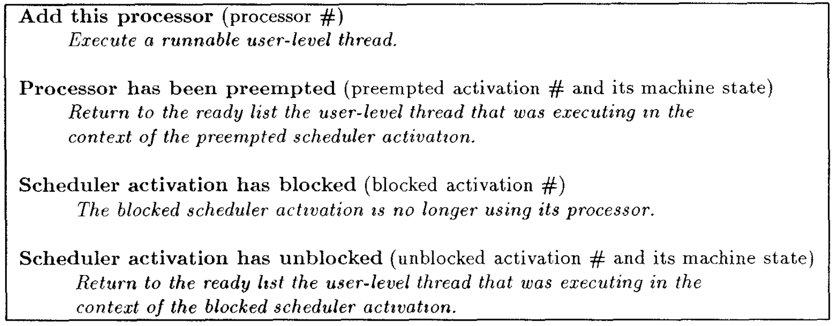
Upcalls and System Calls
Kernel talks to the application through upcalls
Application talks to kernel through system calls
Notes:
The act/process of the kernel alerting the application is called upcalls. The top table lists the upcalls that are available to the kernel.
The user level sends messages to the kernel through system calls, a list of which appears on the bottom table.

Slide 13
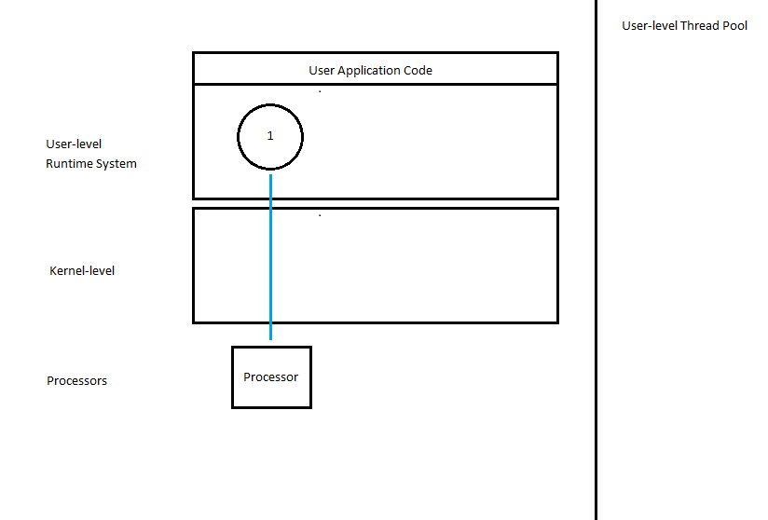

Slide 14
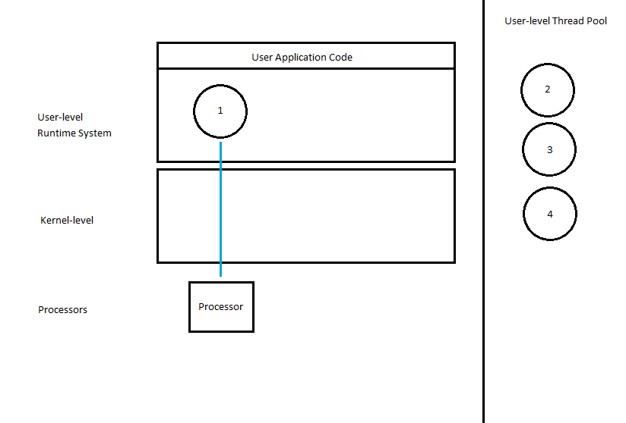

Slide 15
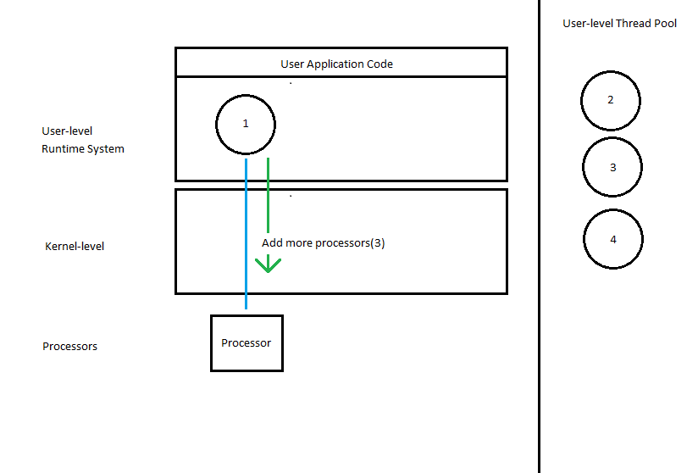

Slide 16
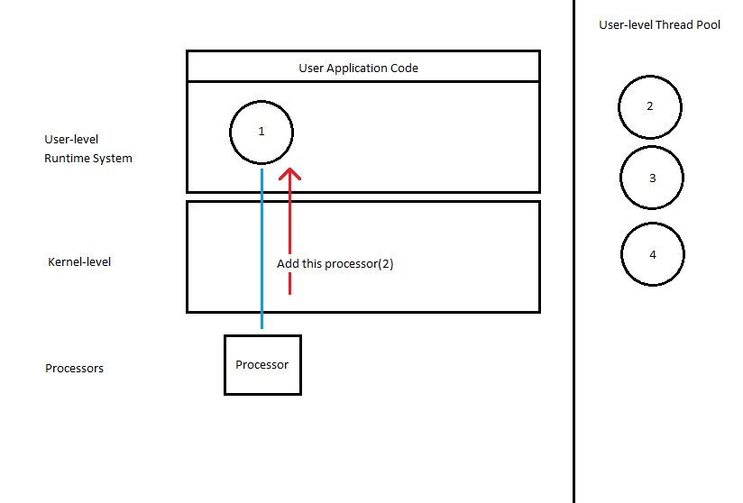

Slide 17
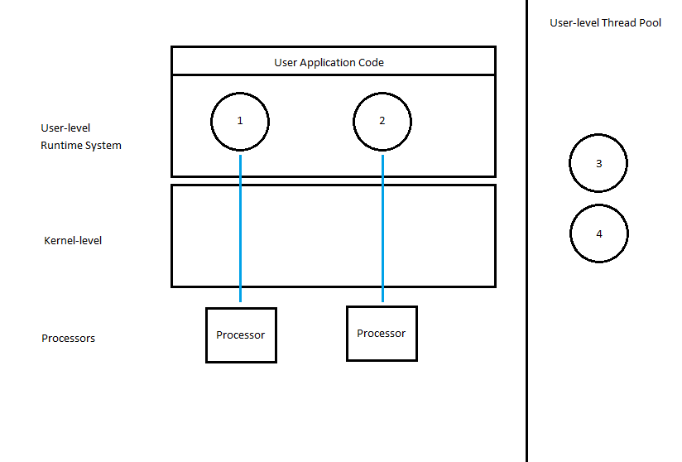

Slide 18
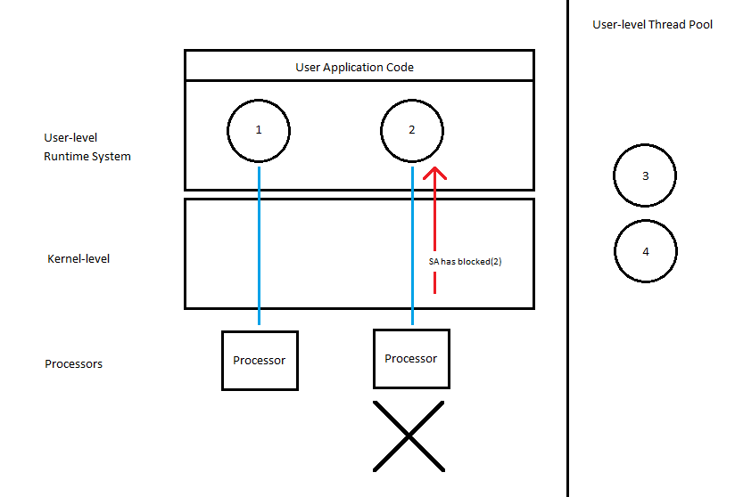

Slide 20
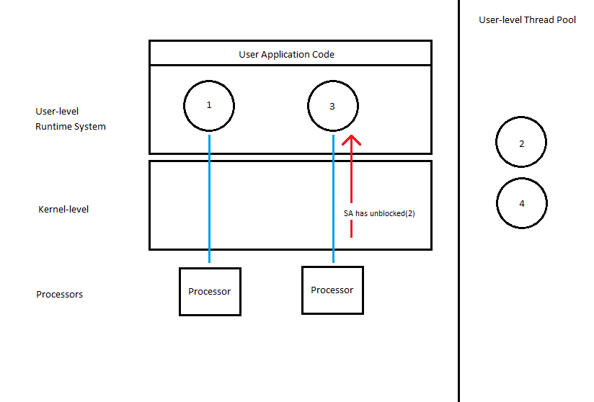

Slide 22
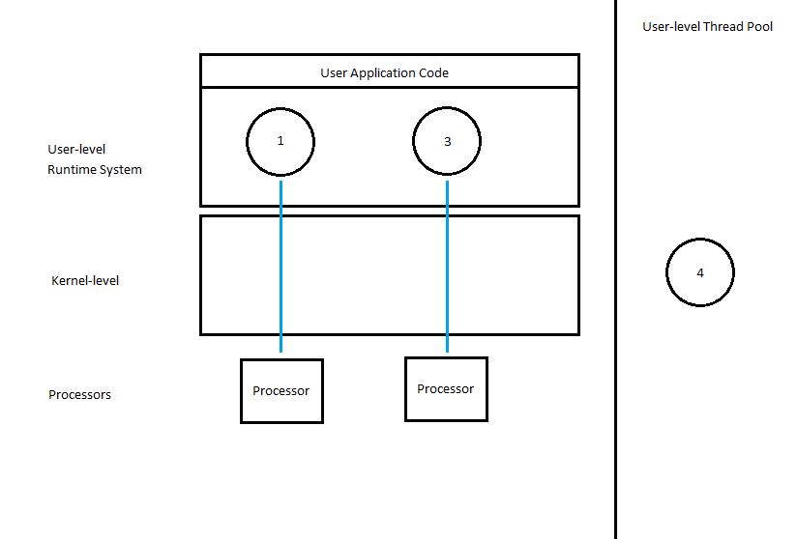

Slide 23
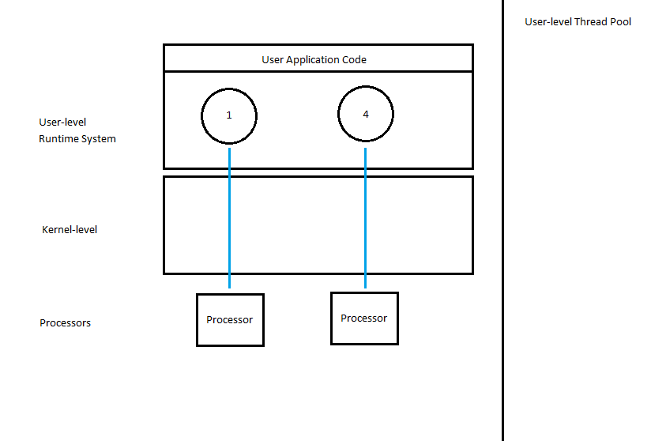

Slide 24
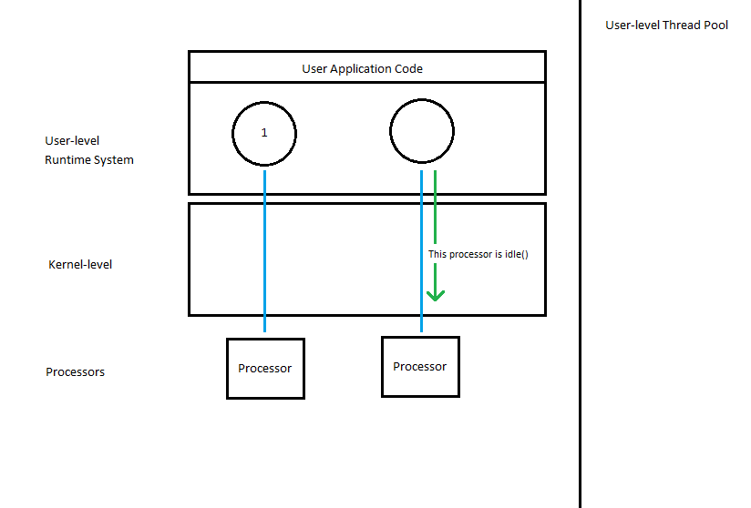

Slide 26
Critical Sections
Potential issues
Prevention vs. Recovery
Upcall handler executes thread
Notes:
When a thread is interrupted in the middle of a critical section, problems can occur.
To avoid problems one of two schemes can be used, either a prevention scheme where the user-code and the kernel
coordinate synchronization and locking so inopportune preemptions are avoided
Or
Recovery, which is used in the paper’s implementation, where the system checks if the thread was in a critical section
When it was preempted, and if it was, it is continued temporarily until it exits the corresponding critical section.

Slide 27
Implementation
DEC SRC Firefly multiprocessor workstation
Modified Topaz OS
Modified FastThreads user-level thread package

Slide 28
Implementation con’t
Guarantees no processor to idle if work can be done
Even distribution of processors among high priority address spaces
Continued support for standard Kernel threads
Applications free to chose scheduling algorithm
Processors wait short time before notifying kernel for reallocation

Slide 29
Optimizations
Critical Sections
Flags have high overhead
Copy critical section code instead
Recycling Scheduler Activations
Notes:
The paper discusses in detail their approach for handling critical sections....
Another optimization the paper made was by recycling scheduler activations

Slide 30
Performance
What is the cost of user-level thread operations?
What is the cost of communication?
What is the effect on application performance?
Notes:
The three questions the paper sought to answer when measuring their implementation was
What is the cost of user-level thread operations as compared to user-level thread libraries
What is the cost of upcalls and system calls
What was the effect on application performance?

Slide 31
Thread Operation Performance
Notes:
Null Fork measures the time to create, schedule, execute and complete a thread that invokes the null procedure.
Signal wait measures the time for a thread to signal a waiting thread and wait on a condition.
This table indicates that Scheduler Activations are slightly slower than FastThreads, but both are an order of magnitude better than kernel threads. The slight slowdowns as compared to FastThreads from SA is due to incrementing and decrementing the number of busy threads and determining whether or not the kernel must be notified.

Slide 32
Communication Cost
More expensive than current kernel thread operations
Potential optimizations could bring it even with Topaz kernel thread operations
Notes:
System call and upcall performance were measured against the standard Topaz kernel threads implementation. It was hypothesized that the two would match, but in the modified FastThreads implementation it was found that there was a slowdown by a factor of 5. The paper states that through a better implementation they believed the two could match.

Slide 33
Application Performance
Tested against O(n * log(n)) solution of N-body problem
Notes:
To test application performance, an O(n log(n)) solution to the N-body problem was run against each threading scheme. The way the problem was developed allowed the authors to control the amount of memory available for the application.

Slide 34
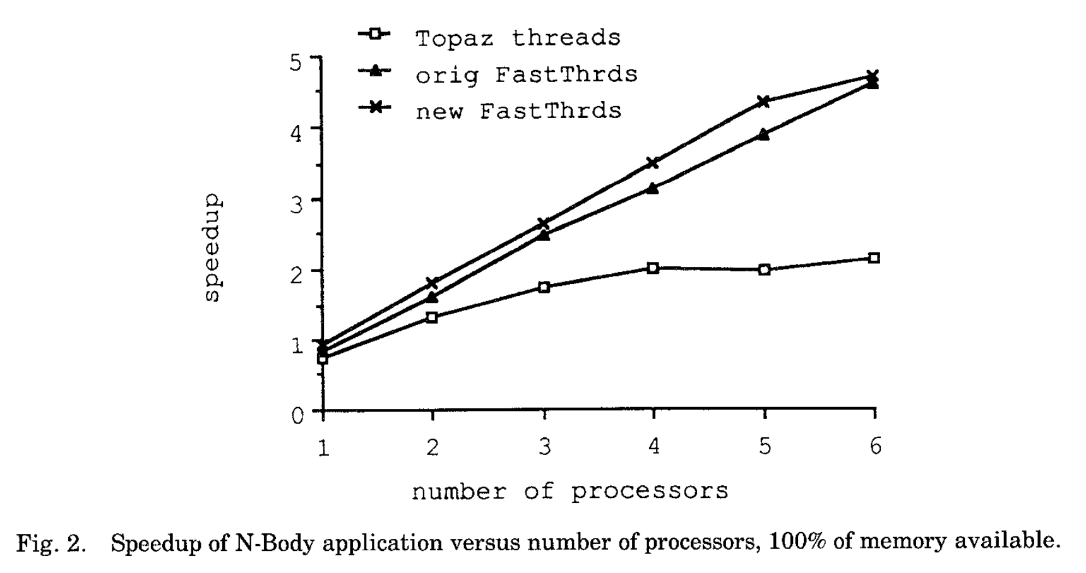
Notes:
Performs slightly better than original FastThreads
Both outperform Topaz kernel threads, especially as the number of processors increases
Only tested up to 6 processors, a limitation of Firefly which they admit

Slide 35
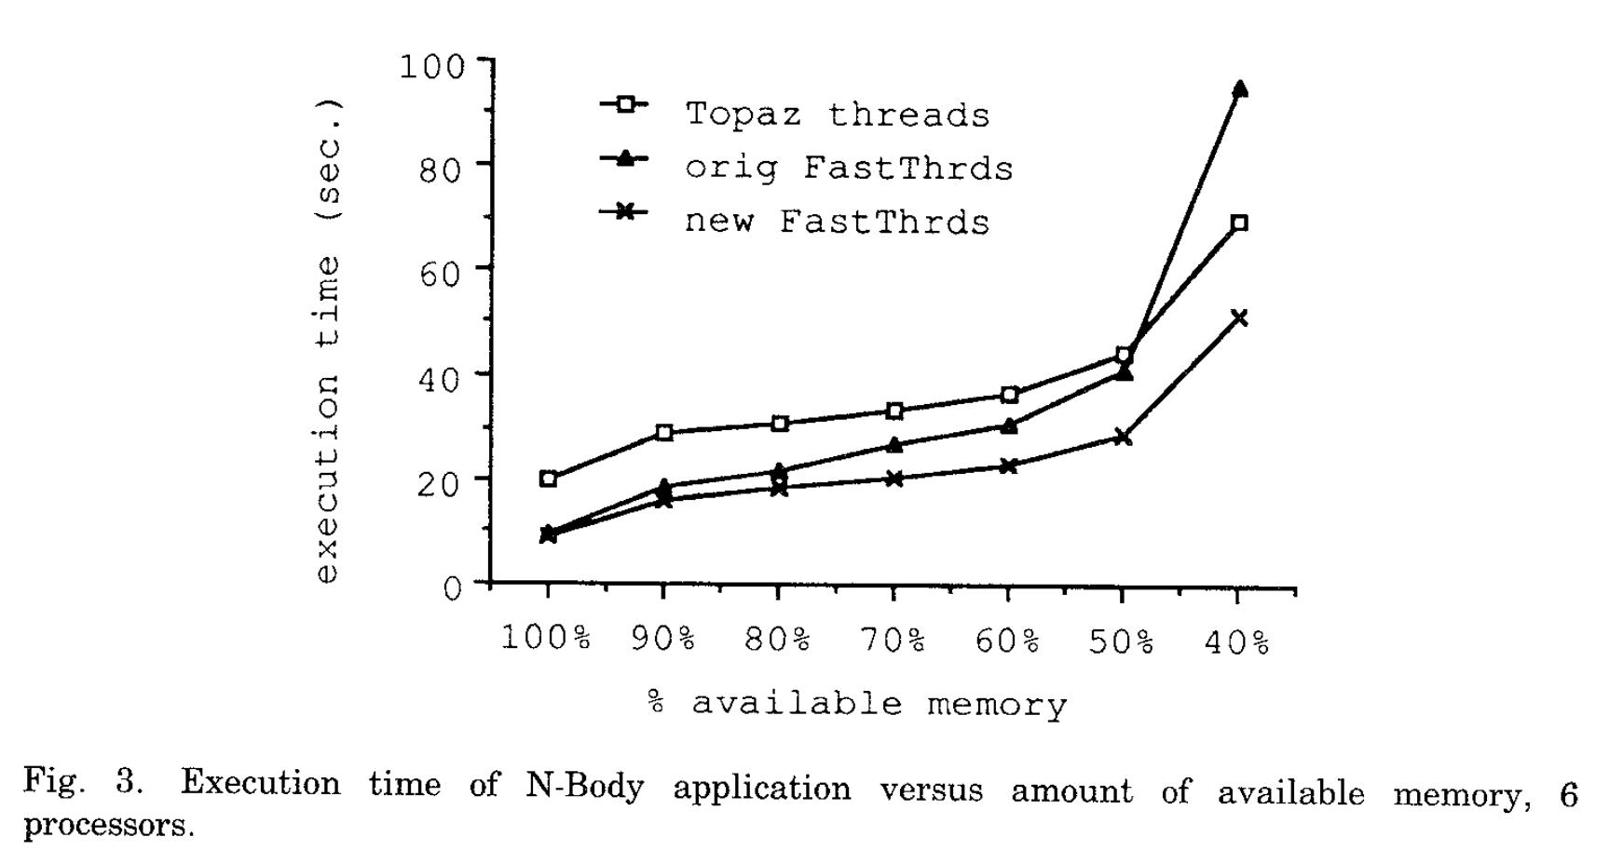
Notes:
Execution time on six processors dependent on the amount of available memory. Modified FastThreads handles cache misses better and performs better for this reason. The original FastThreads greatly struggles when the amount of available memory drops below 50% because when performing I/O the entire process must block.

Slide 36
Notes:
Lastly, two copies of the N-body problem were run together over six processors, and their execution times averaged. The New FastThreads implementation had a much higher speedup than the old setups.
Original FastThreads struggled due to time-slicing. Often threads holding locks would be swapped for threads idling.
Topaz threads were slower because “common thread operations are more expensive”.

Slide 37
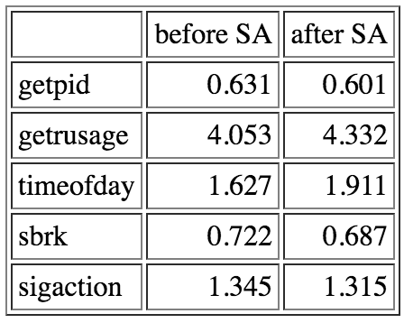
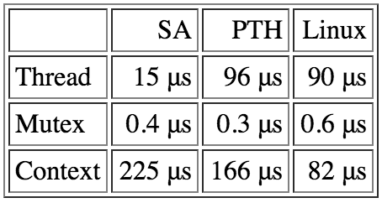
NetBSD Implementation
System call latency measured on a 500 MHz Digital Alpha 21164 system
Thread operation costs mesaured on an Apple iBook with a 500MHz G3 processor and 256k of L2 cache
Notes:
A
An Implementation of Scheduler Activations on the NetBSD Operating System
Results showed that scheduler activations were competitive with current user level threading libraries, but did not provide a significant advantage.

Slide 38
Discussion Points
Scheduler Activations require a process to be honest about the number of threads required. What strategy could be utilized to ensure fairness even in dishonest conditions?
What workloads / processes would be ideal for Scheduler Activations over User-level threading?
How do threads compare to goroutines?

Slide 39
Goroutines
3 Major differences
Memory consumption
Setup / Teardown
Switching
Handling blocks
Synchronization
Notes:
This information was adapted from both Krishna Sundarram’s blog post on goroutines and Traun Leyden’s blog post on goroutines, both of which discuss goroutines vs. java threads
A new goroutine requires only 8kb of stack space as compared to ~1mb that a thread requires. Additionally, goroutines grow by allocating heap storage as required. The smaller overhead for a goroutine allows many more to be created.
Threads often maintain thread pools to reduce the cost of creation and destruction of threads. Goroutines are created and destroyed cheaply enough that this isn’t a worry.
When switching threads, many registers are required to be saved, but with goroutines, only three are saved or restored. These registers are the PC, Stack Pointer, and DX, greatly reducing cost.
Goroutines are implemented on top of a set of threads, and are cheaper because they do not cause the thread they are running on to block when the goroutine is blocked.
Lastly, go provides primitives that allows you to avoid locks. Go handles all synchronization, so it is much harder to run into common thread problems like deadlocks

